Slide 1
Trade Processing – Foreign Exchange

Slide 2
On completion of this tutorial, you will be able to:
describe the different ways in which FX trades can be executed in the market
recognize the requirement for FX trades to be enriched and validated prior to settlement
explain the methods by which trade agreement can be reached between FX trading parties
describe how an FX trade is settled on the value date and the implications of settlement failure
recognize the need for ongoing position and trade management in relation to FX trading

Slide 3
Trade Execution and Capture

Slide 4
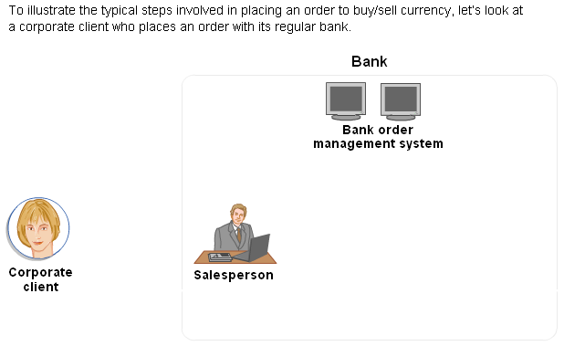
Trade Execution – Order Flow

Slide 5
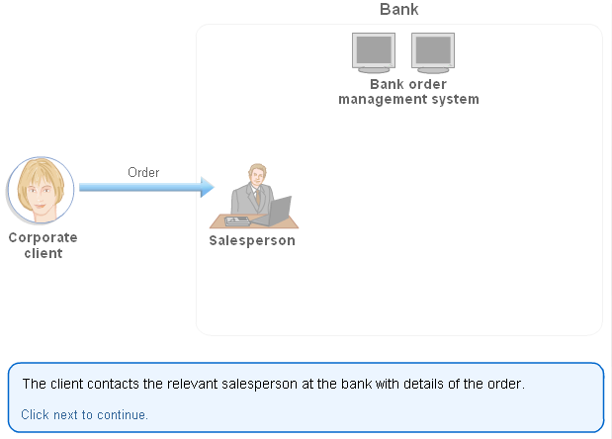
Step -1

Slide 6
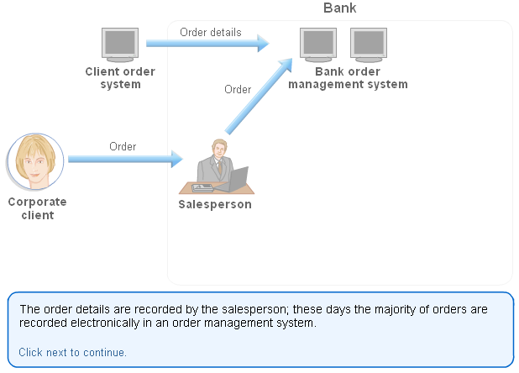
Step - 2

Slide 7
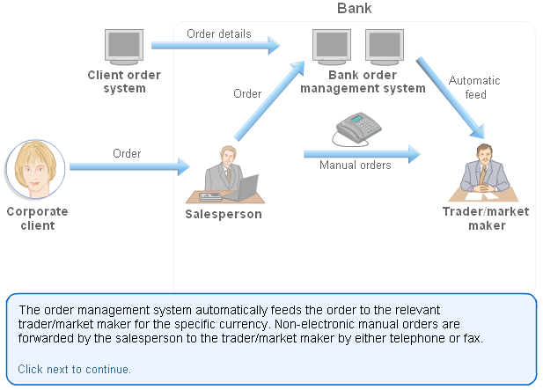
Step - 3

Slide 8
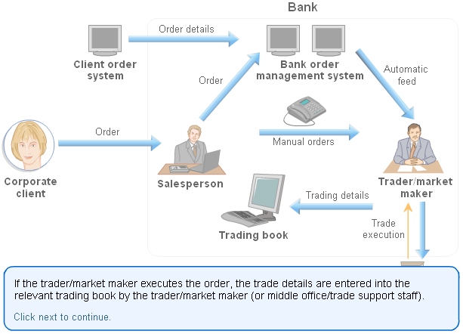
Step - 4

Slide 9
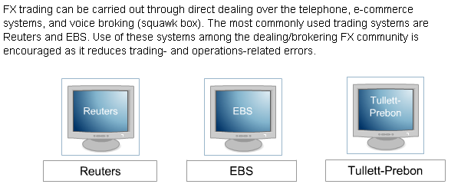
Trade Execution - Markets

Slide 10
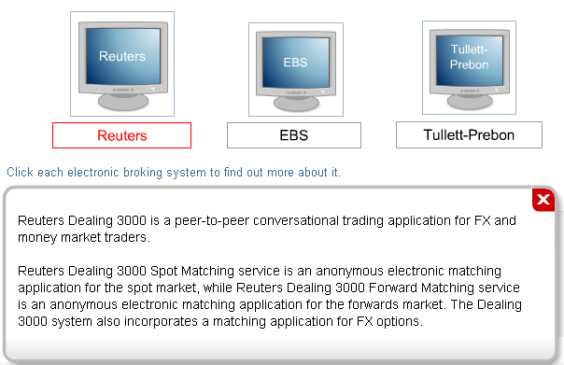
Reuters

Slide 11
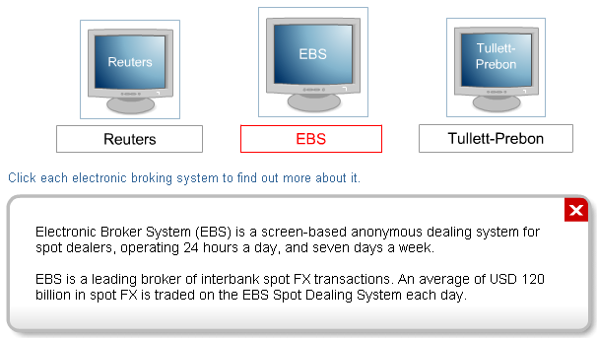
EBS

Slide 12
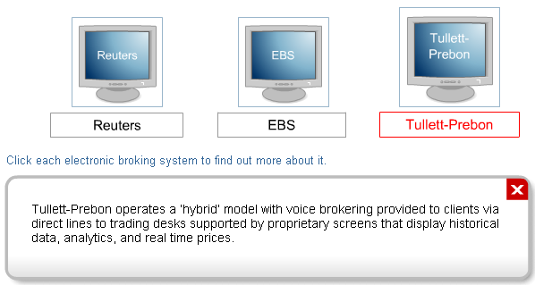
Tullet-Prebon

Slide 13
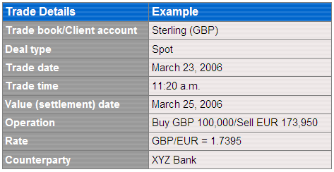
Trade Capture
Once executed, all FX transactions must be formally recorded within the books and records of the trading institution. All trades should be entered immediately to ensure that all systems have timely, updated information. Front-end dealing systems that capture trade details may interface with other systems that monitor credit limits, calculate the intra-day profit and loss (P&L) and trader positions, and update confirmation and settlement details.
The core details of a trade are generally entered by traders/market makers (or trade support personnel) into a trading system designed to manage their positions. In electronic broking systems, the trade details might be automatically captured from the trader’s action on the dealing platform.
Typically trade detail records include the following:
Trade Details Example Trade book/Client account Sterling (GBP) Deal type Spot Trade date March 23, 2006 Trade time 11:20 a.m. Value (settlement) date March 25, 2006 Operation Buy GBP 100,000/Sell EUR 173,950
Rate GBP/EUR = 1.7395 Counterparty XYZ Bank To avoid confusion as to which currency is being traded, each currency is given an ISO code.

Slide 14
Trade Enrichment & Validation

Slide 15
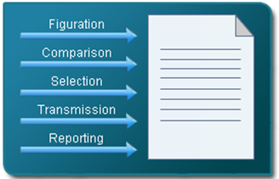
Trade Enrichment
Trade enrichment is the process of applying relevant information to a trade that is necessary in order for the trade to be settled correctly. Trade enrichment incorporates a number of elements.
trade figuration, that is, calculating trade cash values
trade comparison requirement for counterparties (For example, some trades may not require confirmations to be sent if other trade agreement methods are in place.)
selection of the relevant custodian details
transmission of settlement instructions (by SWIFT or fax)
reporting of trades to market regulators

Slide 16
Trade Enrichment in an Automated Environment
In an automated environment, trade enrichment can be primarily achieved through static data defaulting, in other words, by using data from the static data repository.
In many automated systems, the details of trade enrichment are captured as the trade goes through its processing routine. For example, as execution takes place, details like the price/rate or the counterparty’s ID is captured. Also, the money involved with this trade is computed from the tables embedded in the system.
If any static data items are missing, the trade is treated as an exception with processing halted until the necessary information is added to the static data repository.

Slide 17

Trade Figuration
Speed and accuracy in the trade figuration process is vital in order to avoid losses incurred through incorrect computations that can lead to situations like:
trades not matching with counterparties
charging of incorrect monies to clients
The former results in unnecessary expense since reprocessing of the trade calculation is required once again. The latter requires the same expense and is also embarrassing.
At first glance, calculating trade cash values may appear straightforward. For example:
If a client wishes to purchase GBP 100,000 against US dollars at a rate of GBP/USD = 1.80 then the client needs to sell USD 180,000.
However, there are other factors to be considered. For example, commission charges may vary depending on the type of transaction and the currency pair being traded.

